Slide 1
Application of Big Data techniques and machine learning algorithms on environmental data using Weka and Apache Spark
Master degree: Computer Engineering for the Internet of Things
Course: Big Data Analytics
Date: 26/06/2023

Slide 2




Big Data Analytics – Application of Big Data techniques
Idea
What is the project about
Team member/Tasks
Hardware and Software
Alfredo Carnevale: Physical architecture,
224433 Analysis of supplied data
Fabrizio Gabriele: Analysis of collected data,
227506 Node-RED flow, Python scripts, Arduino sketch,
Mario Pingitore: Spark Implementation
225638
Physical architecture and used technologies
First data evaluation
Analysis of supplied dataset using Weka
Data Collection
Generation of new dataset with Node-RED
Collected data evaluation
Analysis of generated dataset using Weka
Spark
Possible new features to be implemented
Summary
Idea
Analysis
Design
Implementation
Simulation
Future
implementation

Slide 3
Big Data Analytics – Application of Big Data techniques
What is it about?
Analysis of a given dataset in order to test the functioning of different algorithms using Weka as testbed
Analysis of the new dataset with Weka using the same algorithms tested before
Implementation of a system able to collect data from different sources in order to create a new dataset
Application of regression algorithms on the new dataset and on a single reading that emulates a fail from the system
Summary
Idea
Summary
Idea
Analysis
Design
Implementation
Simulation
Future Implementation

Slide 4
Big Data Analytics – Application of Big Data techniques
Goals
Testing different algorithms with Weka tool
Apply Big Data techniques in an IoT context
Use machine learning algorithms to predict eventual missing values if some sensor fails
Create a new dataset with data collected from the environment
Idea

Slide 5
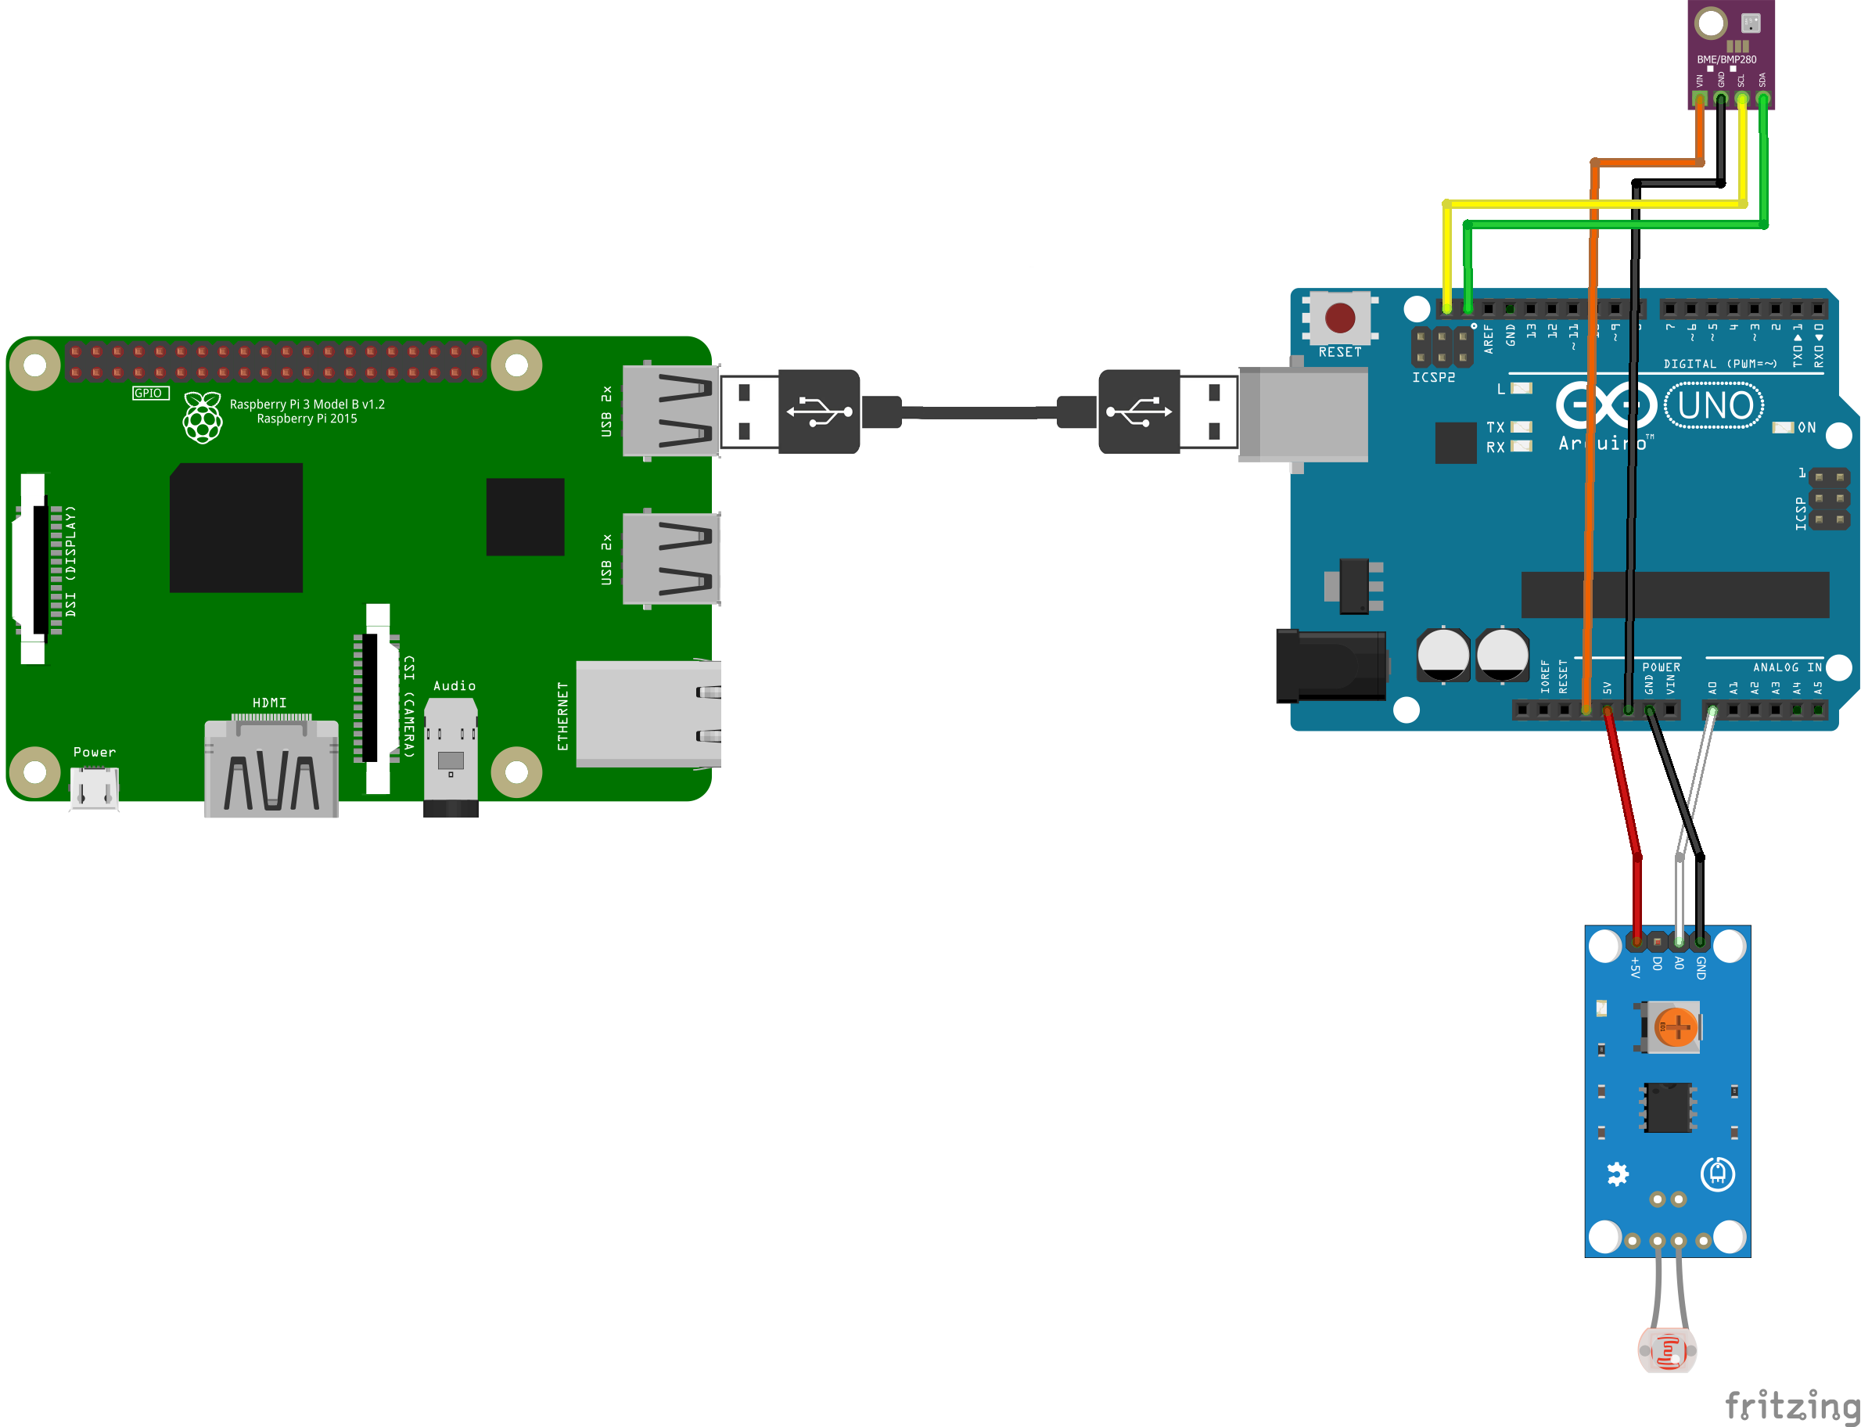
Big Data Analytics – Application of Big Data techniques
Hardware
Raspberry Pi 3
Arduino UNO
Temperature, humidity and atmospheric pressure sensor: BME-280
Light Sensor: LightMH-SENSOR-SERIES Flying Fish
Idea
Hardware
& Software
Idea

Slide 6





Big Data Analytics – Application of Big Data techniques
Software
Hardware
& Software
Idea

Slide 7
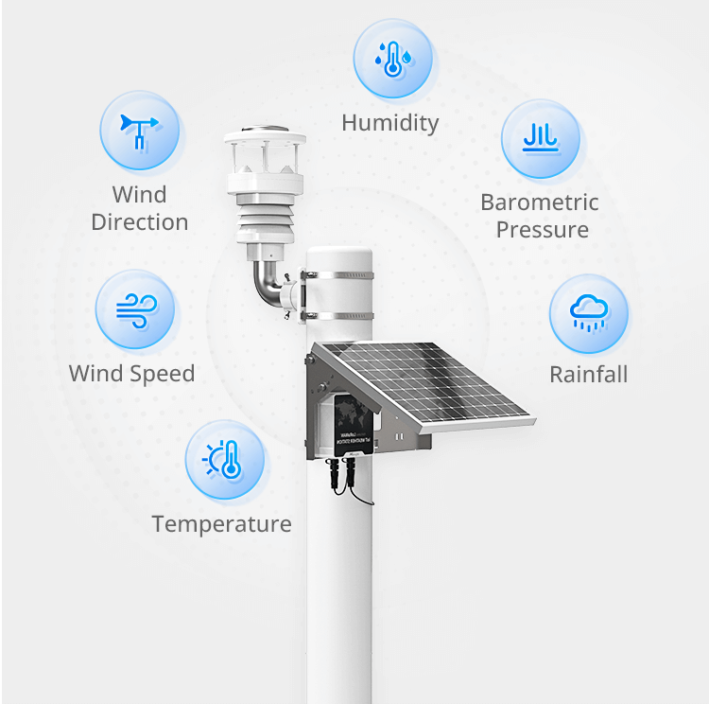
Big Data Analytics – Application of Big Data techniques
Dataset structure
The dataset is composed by the following values located in each row:
timestamp;
wind_speed_value (m/s);
wind_force (m/s
wind_direction;
wind_direction_degrees;
humidity (%);
temperature (°C);
noise (dB);
PM2.5 (μg/m³);
PM10 (μg/m³)
atmospheric_pressure (Kpa)
light (lux);
ligh (hundrer lux);
optical_rainfall (mm);
Hardware
& Software
First Data
Evaluation
Project

Slide 8

Big Data Analytics – Application of Big Data techniques
Dataset manipulation
Original dataset composed by 19 csv files.
Each file represents an acquisition day from 01/12/2022 to 19/12/2022.
Created a python script to merge alle the csv files.
Two modification respect the original csv skeleton:
Adding of the header in the top of the file
Timestamp changed with two values, date and time_range: date taken from the original timestamp, time_range refers to a period of 15 time (ex 00:00-00:15, 00:15-00:30 etc)
First Data
Evaluation

Slide 9
Big Data Analytics – Application of Big Data techniques
Preprocessing
In Big Data Analysis the pre-processing phase is one of the most important because it is the one that allows you to have data that can be processed.
The first operation done was to delete the superfluous values, not useful for our analyses.
date;
time_range;
wind_speed_value (m/s);
wind_force (m/s);
wind_direction_num;
wind_direction_degrees;
humidity (%);
temperature (°C);
noise (dB);
PM2.5 (μg/m³);
PM10 (μg/m³);
atmospheric_pressure (Kpa)
light (lux);
ligh (hundrer lux);
optical_rainfall (mm);
date;
time_range (2 hours interval, ex: 00-02, 02-04);
wind_speed_value (m/s);
wind_force (m/s);
wind_direction_num;
wind_direction_degrees;
humidity (%);
temperature (°C);
noise (dB);
PM2.5 (μg/m³);
PM10 (μg/m³);
atmospheric_pressure (Kpa);
light (lux);
ligh (hundrer lux);
optical_rainfall (mm);
First pre-processing step
First Data
Evaluation

Slide 10
Big Data Analytics – Application of Big Data techniques
Preprocessing
Before to apply the classification algorithms, each value has been discretized
wind_force discretized in 4 bins
humidity 4 bins
temperature 4 bins
PM2.5 3 bins
light, first step discretized in 5 bins, after the last 4 bins was merged in order to create only one bin. This choice in order to have two balanced bins.
First Data
Evaluation

Slide 11
Big Data Analytics – Application of Big Data techniques
Clistering
First Data
Evaluation

Slide 12
Big Data Analytics – Application of Big Data techniques
Association cules
First Data
Evaluation

Slide 13
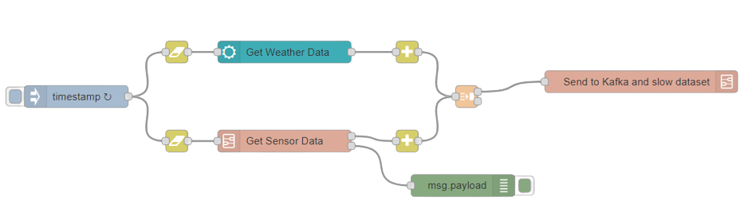
Big Data Analytics – Application of Big Data techniques
Main flow
2 different parallel flows
2 data sources
3 subflows:
weather data collection;
sensor data collection;
data storage and delivering
Connected with all the other components
First Data
Evaluation
Data Collection
Scope & Time

Slide 14
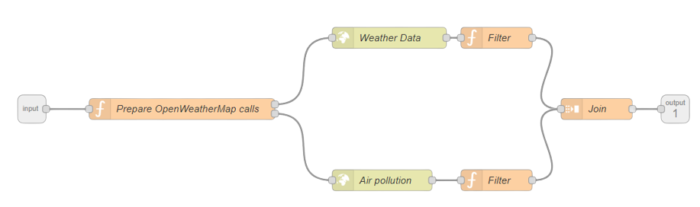
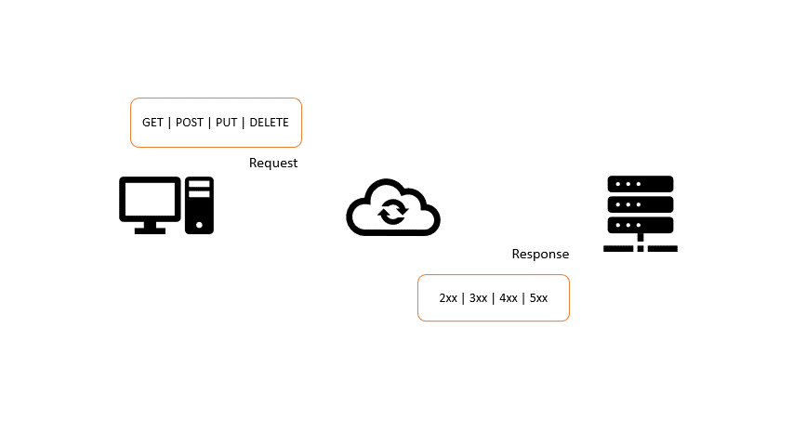


Big Data Analytics – Application of Big Data techniques
Weather API flow
2 parallel HTTP REST API calls
Geographic coordinates of local environment
Data Collection
Responsibilities

Slide 15

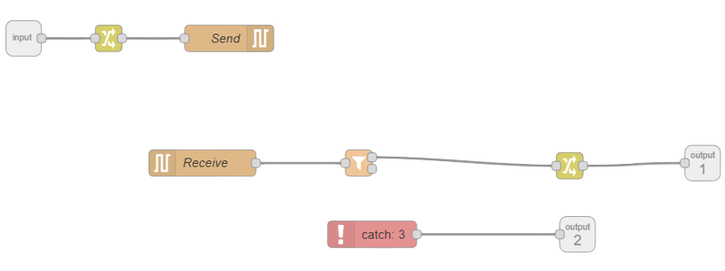
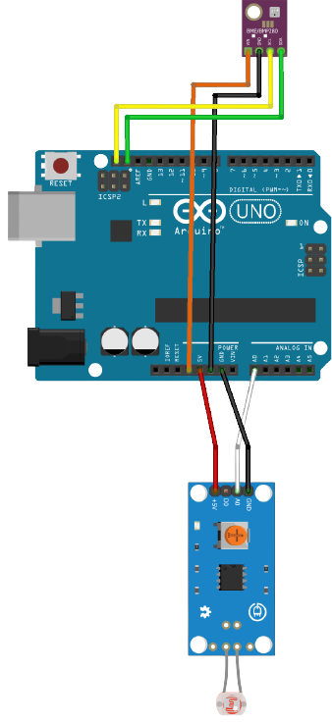
Big Data Analytics – Application of Big Data techniques
Sensor data collection
Serial communication
Flow detection mechanism
Data Collection
Responsibilities

Slide 16

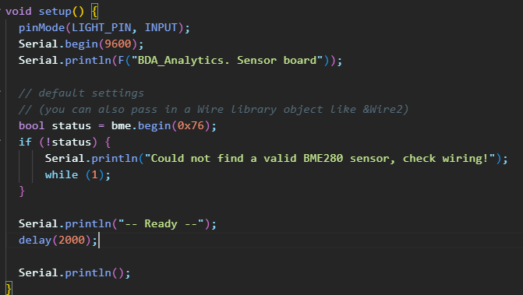


Big Data Analytics – Application of Big Data techniques
Sensor data collection
Pin setup
Loop
Data retrieval
Data Collection
Responsibilities

Slide 17
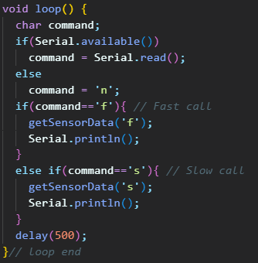
Big Data Analytics – Application of Big Data techniques
Sensor data collection
Pin setup
Loop
Data retrieval
Data Collection
Responsibilities

Slide 18
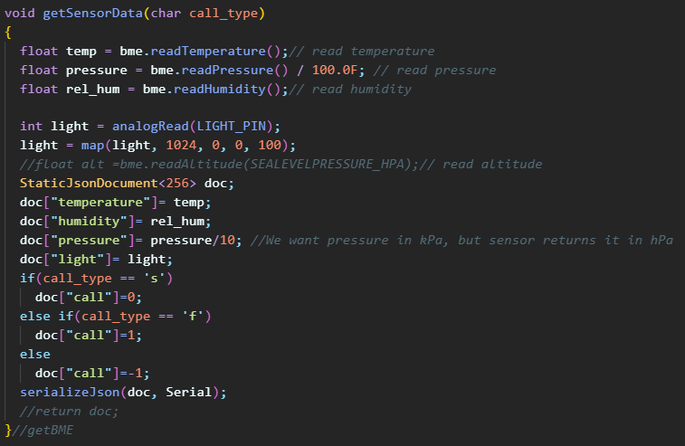
Big Data Analytics – Application of Big Data techniques
Sensor data collection
Pin setup
Loop
Data retrieval
Data Collection
Responsibilities

Slide 19
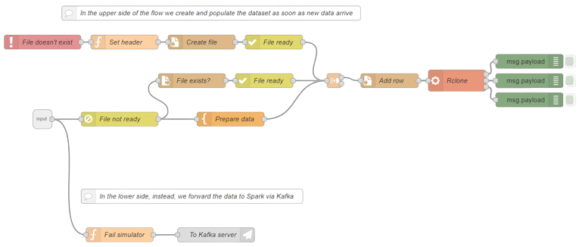

Big Data Analytics – Application of Big Data techniques
Storage and forward
Row insertion in the dataset
Row delivery to Kafka
Sync with Google Drive
Data Collection
Responsibilities

Slide 20
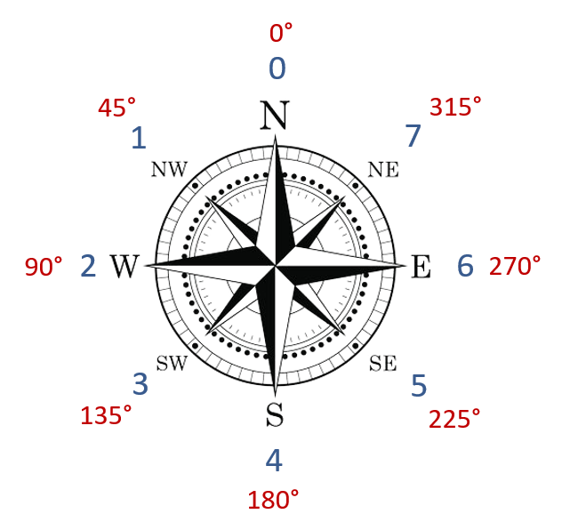
Big Data Analytics – Application of Big Data techniques
Dataset
The dataset contains 3730 rows collected from 6th of March to 27th of April and is structured in this way:
Timestamp (UNIX format);
Humidity (%);
Light;
Pm10 (μg/m³);
Pm2.5 (μg/m³);
Atmospheric pressure (kPa);
Rainfall (mm);
Temperature (°C);
wind_speed (m/s);
wind_force (Beaufort);
wind_direction;
wind_direction_degrees (°);
Timerange (2-hour long);
Humidity (%);
Light;
Pm10 (μg/m³);
Pm2.5 (μg/m³);
Atmospheric pressure (kPa);
Rainfall (mm);
Temperature (°C);
wind_speed (m/s);
wind_force (Beaufort);
wind_direction;
wind_direction_degrees (°);
First preprocessing step
Data Collection
Collected Data Evaluation
Budget

Slide 21
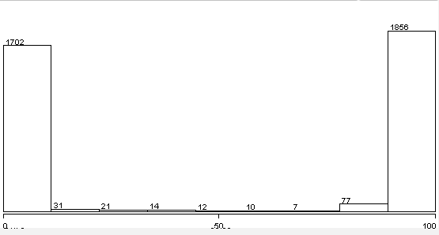
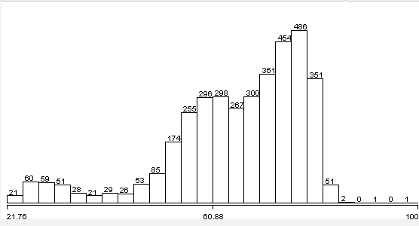
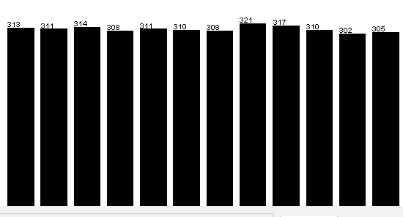
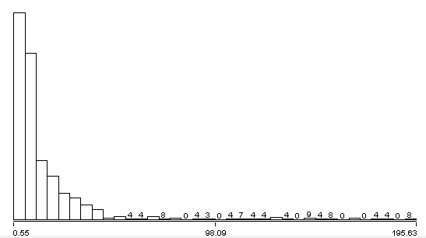
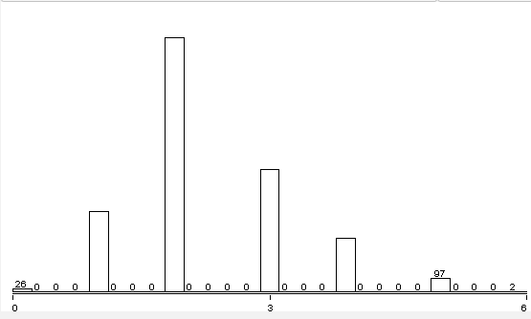
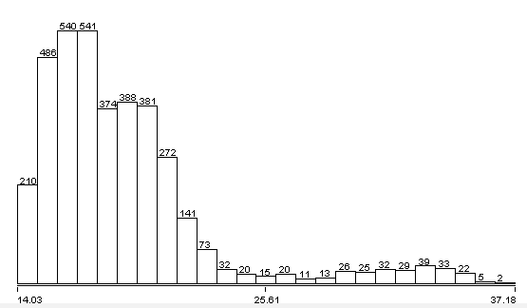
Big Data Analytics – Application of Big Data techniques
Dataset
Light
Humidity
Pm2.5
Wind force
Temperature
Time range
Data Collection
Collected Data Evaluation
Budget

Slide 22
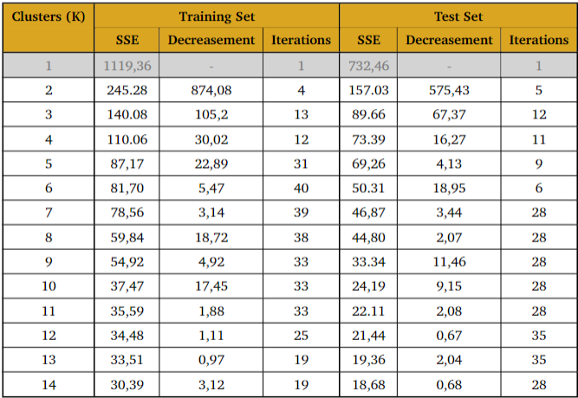
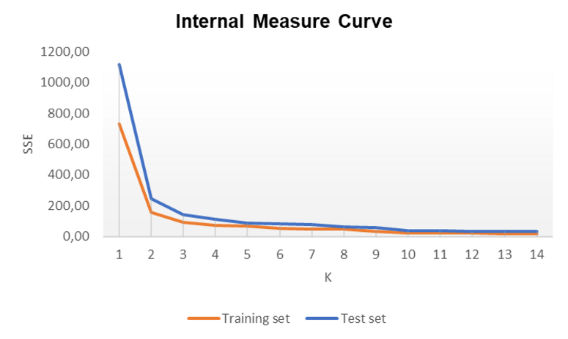
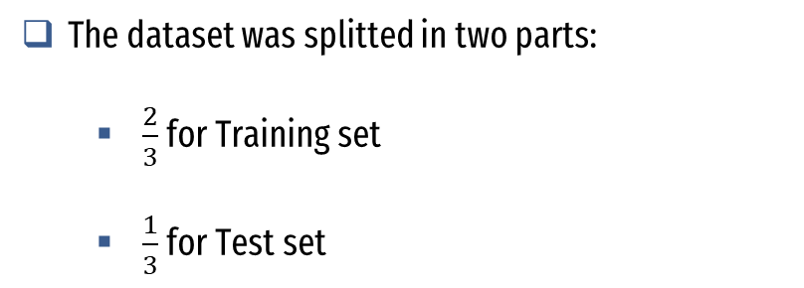
Big Data Analytics – Application of Big Data techniques
Clustering
K-Means
Due to poor performance results, these columns have been removed too:
Time range
Wind force
The dataset was splitted in two parts:
$\frac{2}{3}$ for Training set
$\frac{1}{3}$ for Test set
Collected Data Evaluation

Slide 23
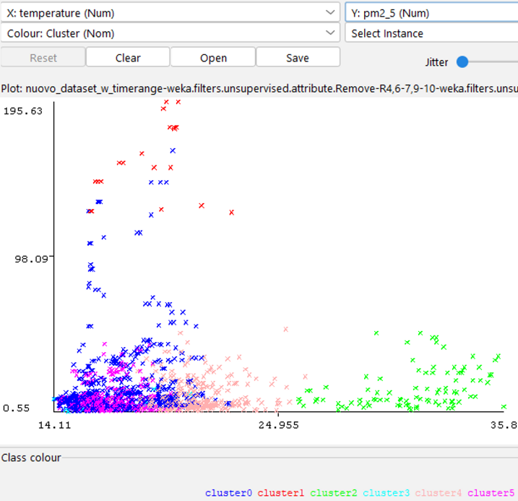
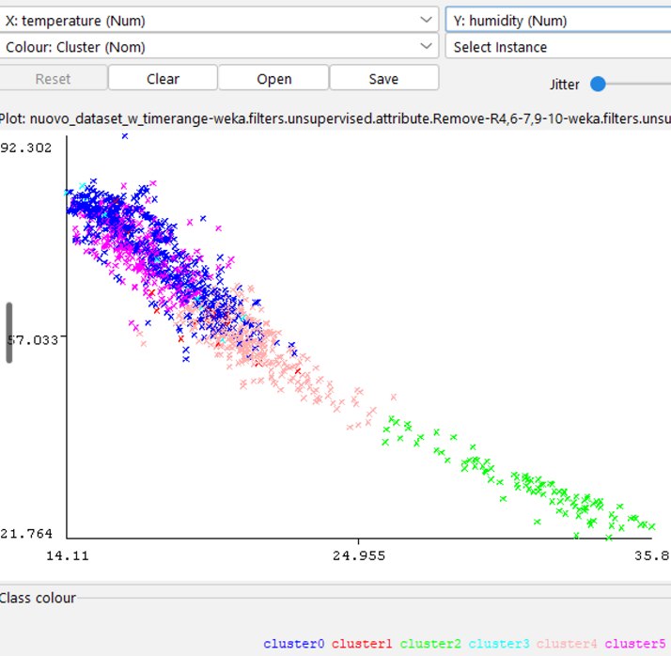

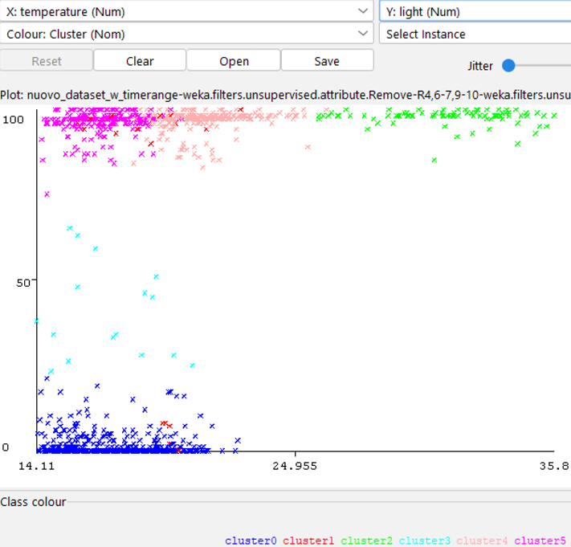
Big Data Analytics – Application of Big Data techniques
Clustering
Temperature – Humidity correlation in clusters
Temperature – pm2.5 (6 clusters)
Temperature – Humidity (3 clusters)
Temperature – Light (6 clusters)
Temperature – Humidity (6 clusters)
Collected Data Evaluation

Slide 24
Big Data Analytics – Application of Big Data techniques
Classification
Preprocessing
Naive Bayes
KNN
Random Forest
K-Star
Before applying algorithms, each column needs to be discretized:
4 bins for temperature;
4 bins for humidity;
2 bins for light;
3 bins for pm2.5;
wind_force and timerange are already discretized
Collected Data Evaluation

Slide 25
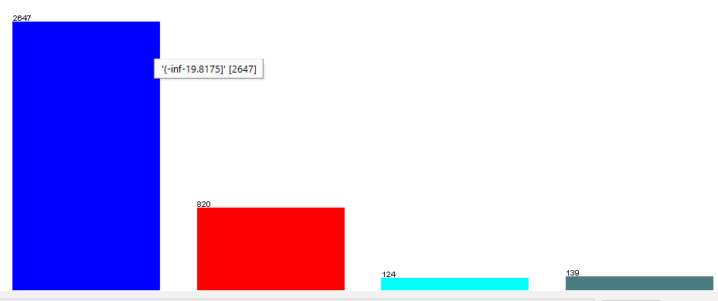
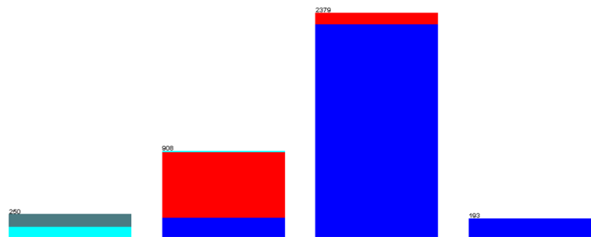
Big Data Analytics – Application of Big Data techniques
Classification
Temperature bins
Preprocessing
Naive Bayes
KNN
Random Forest
K-Star
Correlation between temperature and humidity
Humidity bins
Collected Data Evaluation

Slide 26
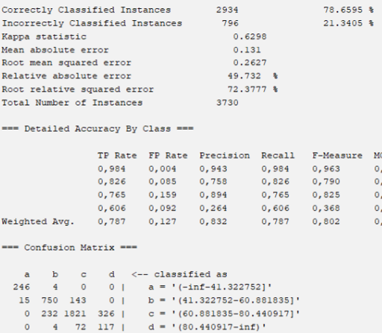
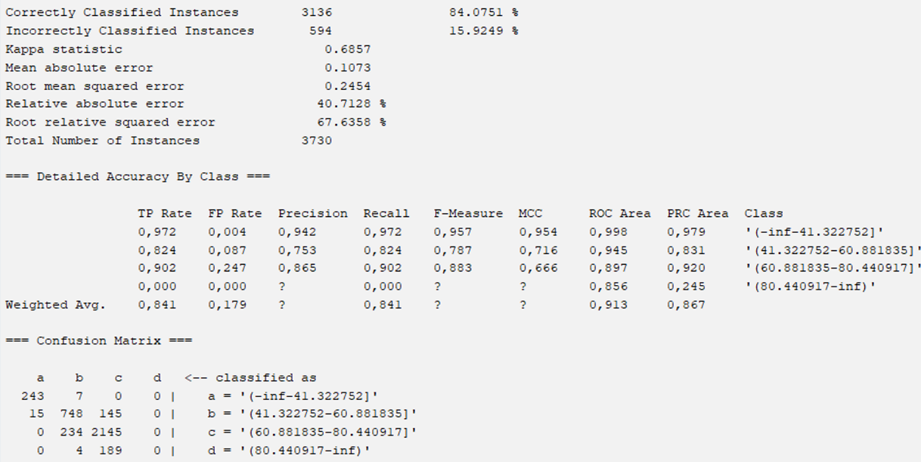
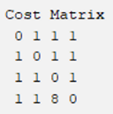
Big Data Analytics – Application of Big Data techniques
Classification
Classification for humidity
Preprocessing
Naive Bayes
KNN
Random Forest
K-Star
Collected Data Evaluation

Slide 27
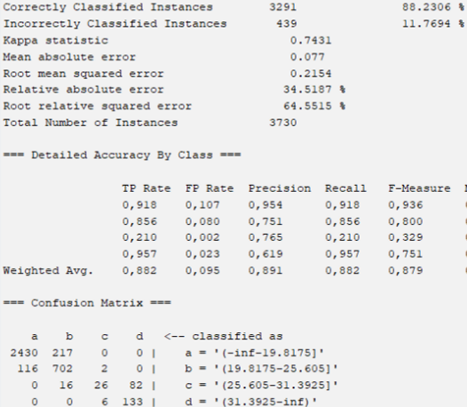
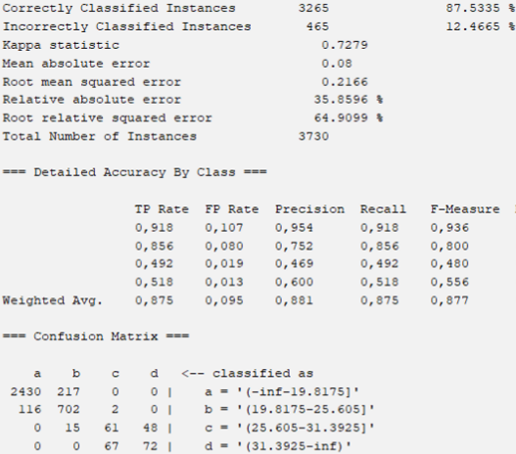
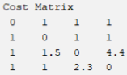
Big Data Analytics – Application of Big Data techniques
Classification
Classification for temperature
Preprocessing
Naive Bayes
KNN
Random Forest
K-Star
Collected Data Evaluation

Slide 28
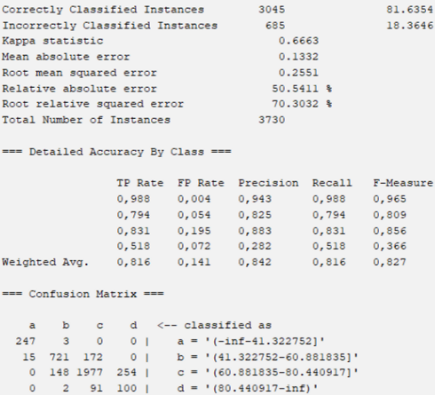
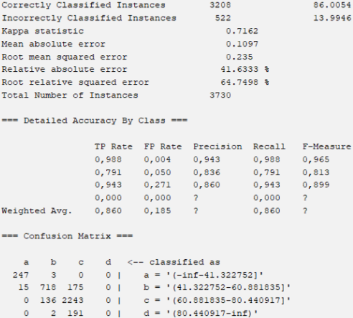
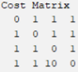
Big Data Analytics – Application of Big Data techniques
Classification
Classification for humidity
Preprocessing
Naive Bayes
KNN
Random Forest
K-Star
+ 3% respect to Naive Bayes
Best parameters:
K = 7;
Search Algorithm = KDTree.
Collected Data Evaluation

Slide 29
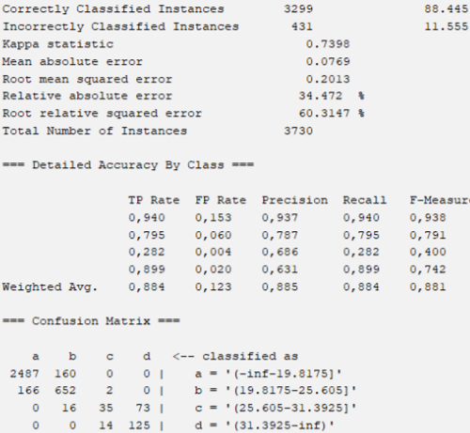
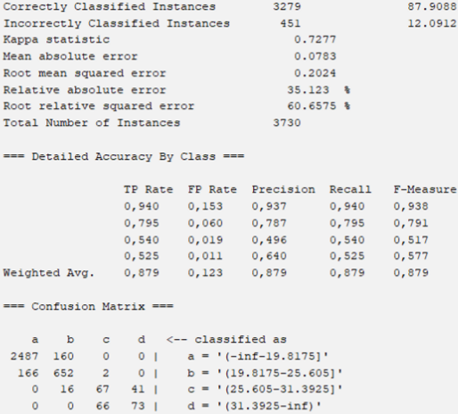
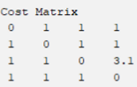
Big Data Analytics – Application of Big Data techniques
Classification
Classification for temperature
Preprocessing
Naive Bayes
KNN
Random Forest
K-Star
Best parameters:
K = 3;
Search Algorithm = LinearNN;
Distance Function = Euclidean
Collected Data Evaluation

Slide 30
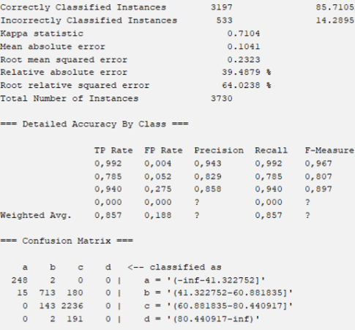
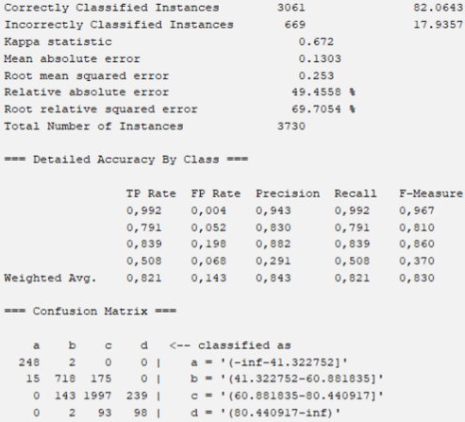
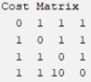
Big Data Analytics – Application of Big Data techniques
Classification
Classification for humidity
Preprocessing
Naive Bayes
KNN
Random Forest
K-Star
+ 0.4% respect to KNN
Collected Data Evaluation

Slide 31
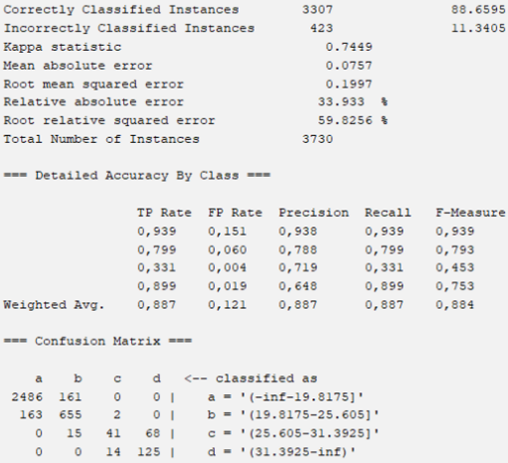
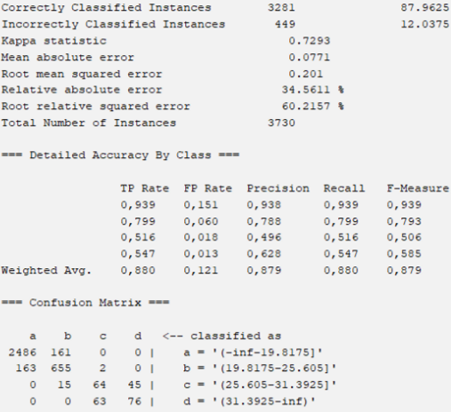
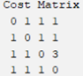
Big Data Analytics – Application of Big Data techniques
Classification
Classification for temperature
Preprocessing
Naive Bayes
KNN
Random Forest
K-Star
+ 0.06 % respect to KNN
Collected Data Evaluation

Slide 32
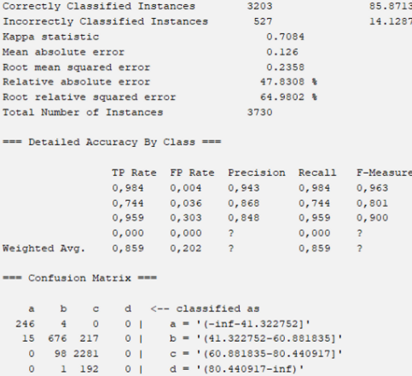
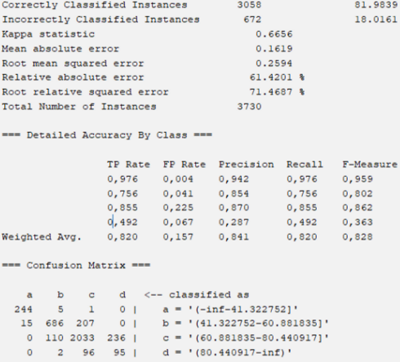
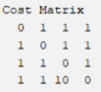
Big Data Analytics – Application of Big Data techniques
Classification
Classification for humidity
Preprocessing
Naive Bayes
KNN
Random Forest
K-Star
Best parameters:
Blend = 16;
Collected Data Evaluation

Slide 33
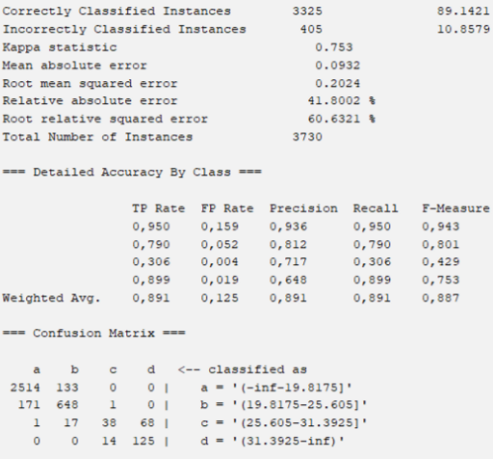
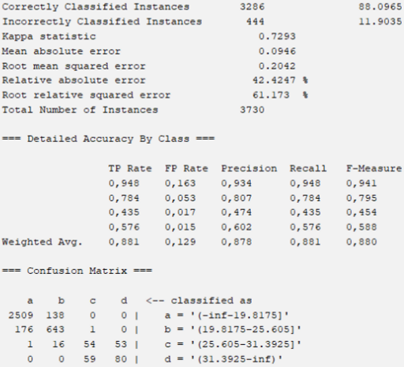
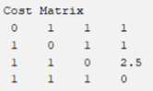
Big Data Analytics – Application of Big Data techniques
Classification
Classification for temperature
Preprocessing
Naive Bayes
KNN
Random Forest
K-Star
Best parameters:
Blend = 17;
Collected Data Evaluation

Slide 34

Big Data Analytics – Application of Big Data techniques
Classification
We tried to obtain balanced results for each algorithm
A result is considered balanced only if every element is correctly classified more often than wrongly classified
Random Forest produced the best results
Collected Data Evaluation

Slide 35

Big Data Analytics – Application of Big Data techniques
Association Rules
Parameters for mining association rules:
# elements = 3730
Minimum Support = 40% (1492)
Confidence = 0.9
Tests performed using Apriori and FP-Growth algorithms
Collected Data Evaluation

Slide 36



Big Data Analytics – Application of Big Data techniques
Association Rules
Analysis of frequent itemsets:
6 1-itemsets (all of them are closed);
7 2-itemsets (5 closed and 2 maximal);
2 3-itemsets (2 maximal).
Collected Data Evaluation

Slide 37

Big Data Analytics – Application of Big Data techniques
Project Structure
Virtual environment (venv)
TrainedModel folder
Main
5 different regression algorithms
Correlation Test
Collected Data Evaluation
Machine Learning implementation
Budget
Risks

Slide 38

Big Data Analytics – Application of Big Data techniques
Kafka Setup
Before setup:
Uncomment and modify config.properties
Clear the log folder
Distance Function = Euclidean
Setup
Zookeper
Server
Topic
./bin/windows/zookeeper-server-start.bat config/zookeeper.properties
./bin/windows/kafka-topics.bat --create --bootstrap-server 192.168.43.204:9094 --replication-factor 1 --partitions 1 --topic RaspTest
./bin/windows/kafka-server-start.bat config/server.properties
Machine Learning implementation
Risks

Slide 39

Big Data Analytics – Application of Big Data techniques
Kafka Setup
Consumer implementation
Kafka-python
Same topic as the Node-Red Producer
Receive a JSON message
Machine Learning implementation
Risks

Slide 40

Big Data Analytics – Application of Big Data techniques
Main
setLabel
Save the received JSON message
Check if there is a value set to NULL
Extract the label from the message
callRegressionTests
Run Correlation Test
Launch all the Regression Algorithms in sequence
Keep listening
Machine Learning implementation
Risks

Slide 41




Big Data Analytics – Application of Big Data techniques
Correlation Test
Machine Learning implementation
Risks

Slide 42







Big Data Analytics – Application of Big Data techniques
Linear Regression
Flow to prediction
initialize
filterTimestamp
cacheDataFrame
vectorizeDataframe
splitDataframe
linearRegression
trainOrLoad
predictAndEvaluate
Machine Learning implementation
Risks

Slide 43


Big Data Analytics – Application of Big Data techniques
Isotonic Regression
Machine Learning implementation
Risks

Slide 44




Big Data Analytics – Application of Big Data techniques
Decision Tree
Machine Learning implementation
Risks

Slide 45


Big Data Analytics – Application of Big Data techniques
Gradient Boosting Tree / Random Forest
Machine Learning implementation
Risks

Slide 46
Big Data Analytics – Application of Big Data techniques
Results – Linear, Isotonic
Parameters of the test
Label to predict: temperature
CrossValidator:
Folds: 5
Parallelism: 3
5 run for each algorithm:
Showed the one with the average value of RMSE
Showed the first 5 value predicted
Real values | Linear
33.98 | 31.2540
34.15 | 31.3890
37.18 | 35.7766
36.29 | 33.7722
36.17 | 30.7569
RMSE | 1.2866
Real values | Isotonic
34.23 | 34.9828
33.98 | 34.9828
34.68 | 34.9828
35.80 | 34.6823
36.17 | 34.6823
RMSE | 0.9449
Machine Learning implementation
Risks

Slide 47
Big Data Analytics – Application of Big Data techniques
Results – Prediction of the missing value
Real values | DecisionTree
34.23 | 34.2200
34.15 | 34.1500
35.40 | 34.9150
35.06 | 34.9150
33.65 | 33.0150
RMSE | 0.3685
Real values | GBTree
33.01 | 33.3885
34.15 | 33.4693
37.18 | 35.8182
34.68 | 33.4718
34.33 | 33.4693
RMSE | 0.5414
Real values | Random Forest
37.18 | 35.3412
33.58 | 33.3794
34.21 | 33.2916
31.59 | 32.1981
34.76 | 34.7337
RMSE | 0.2642
Machine Learning implementation
Risks

Slide 48
Big Data Analytics – Application of Big Data techniques
Results – Prediction of the missing value
Real values | Random Forest
37.18 | 3.3412
33.58 | 33.3794
34.21 | 33.2916
31.59 | 32.1981
34.76 | 34.7337
RMSE | 0.2642
Algorithms | Real Value: 33.03 | RMSE
Linear | 35.3338 | 2.3038
Isotonic | 34.5801 | 1.5501
DecisionTree | 33.6952 | 0.6652
GBTree | 34.0936 | 1.0636
RandomForest | 33.3613 | 0.3313
Best results!
Machine Learning implementation
Risks

Slide 49
Thanks for the attention!

